Slide 1

WIPRO NGA Program – Datacenter Batch
Capstone Project Presentation – 06 April 2024
Project Title Here -
Presented by -
www.rpsconsulting.in

Slide 2
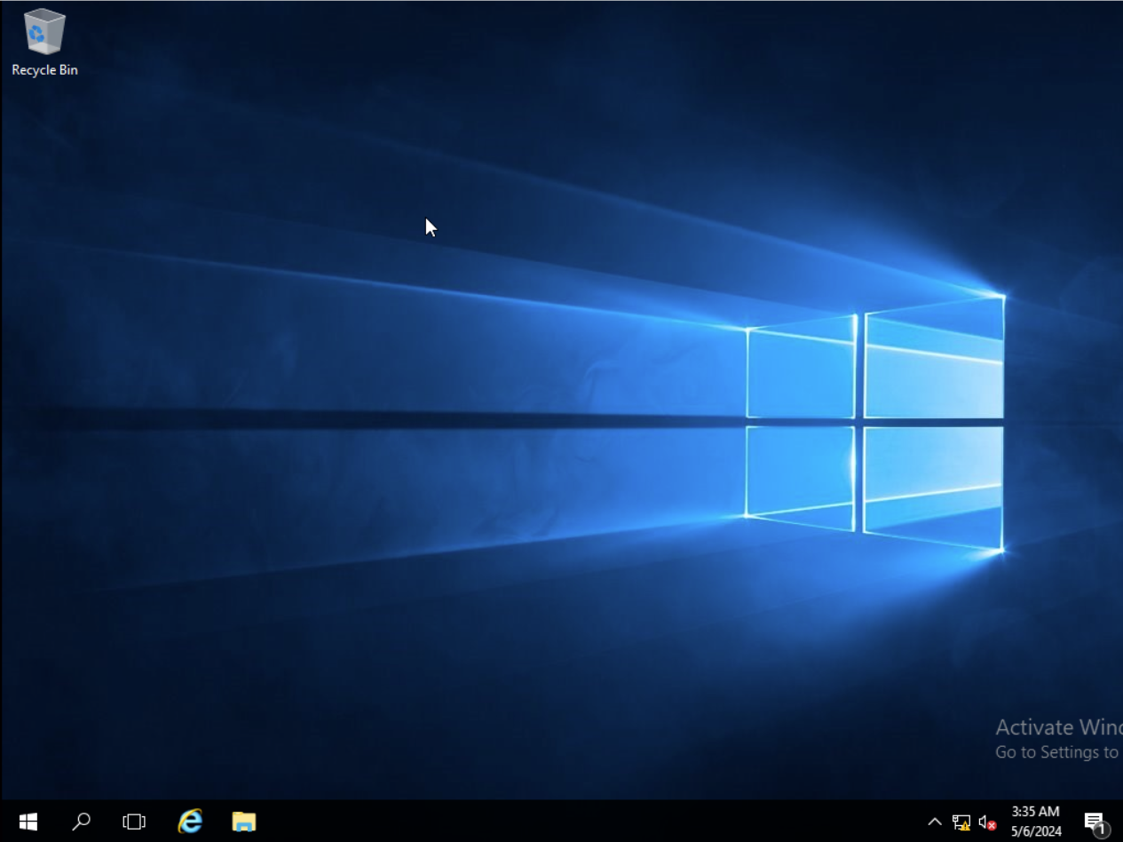

Dc_Server Machine:
2024 - RPS Consulting all rights reserved

Slide 3
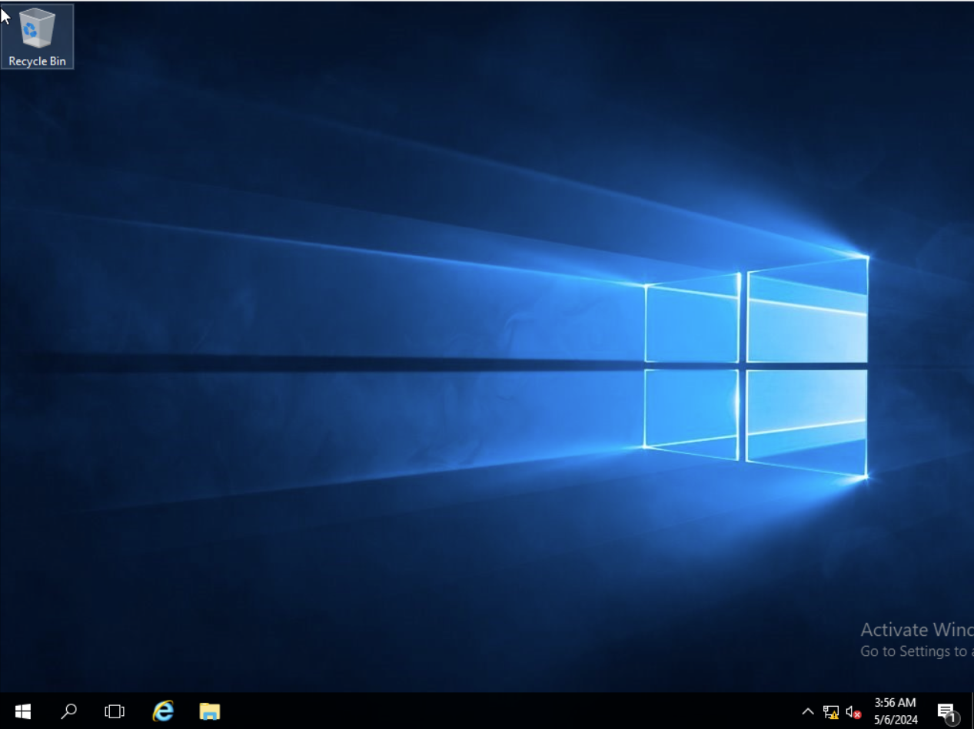
Member Machine (Already Domain joined with server):
2024 - RPS Consulting all rights reserved

Slide 4
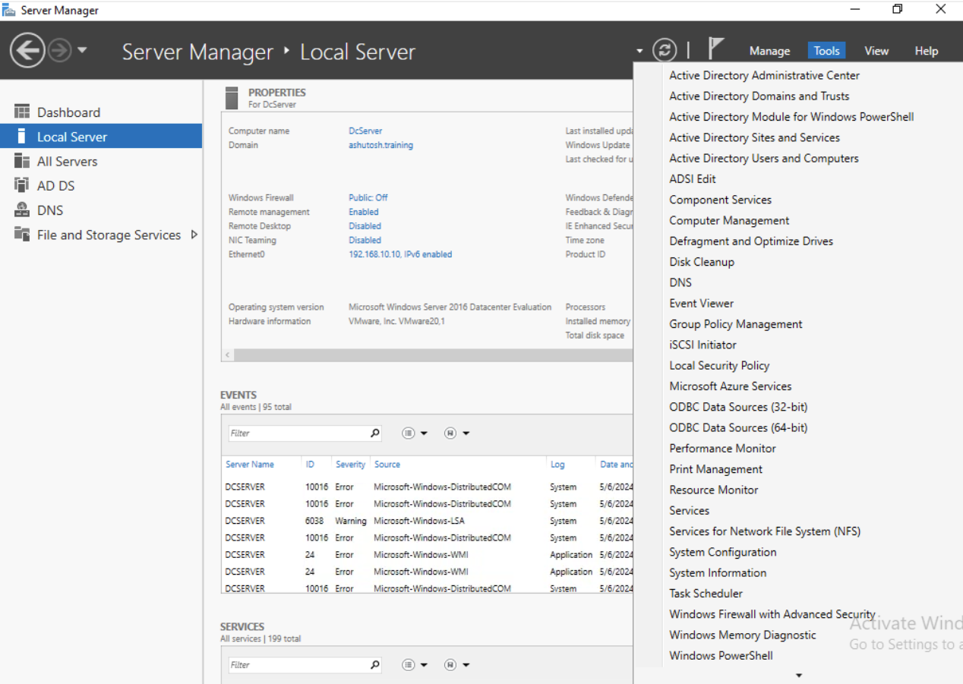
Go to tools & select “Group Policy Management”:
2024 - RPS Consulting all rights reserved

Slide 5
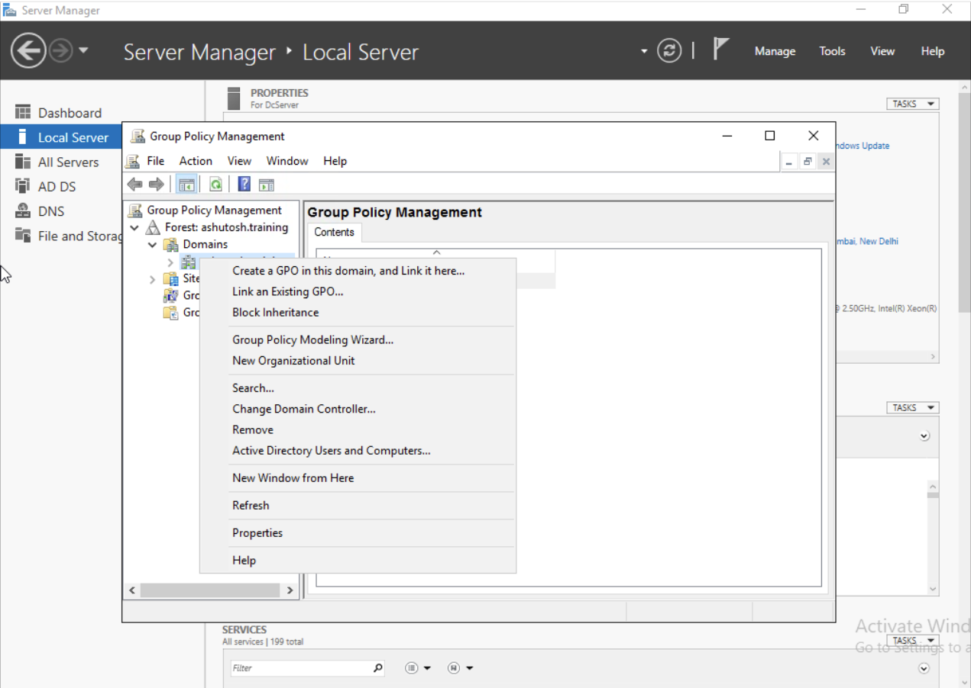
Right Click on Domain name & select “Create a GPO…” option:
2024 - RPS Consulting all rights reserved

Slide 6
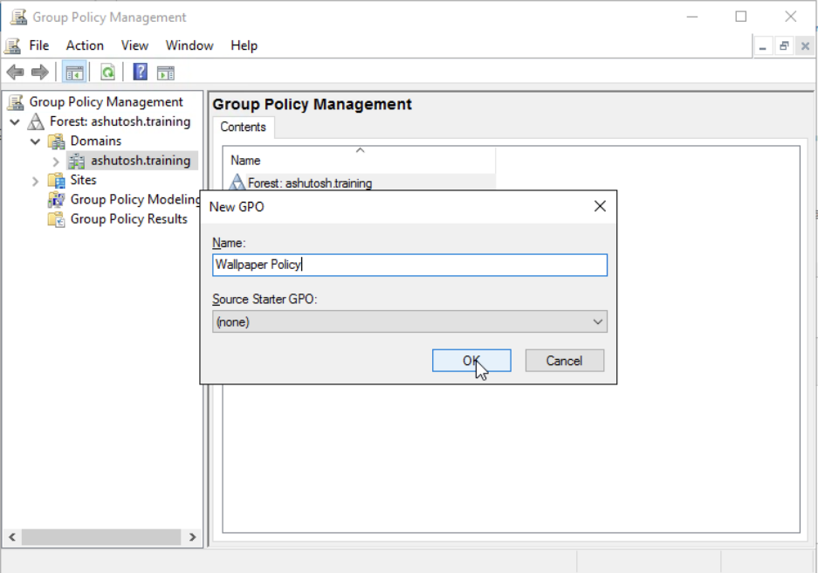
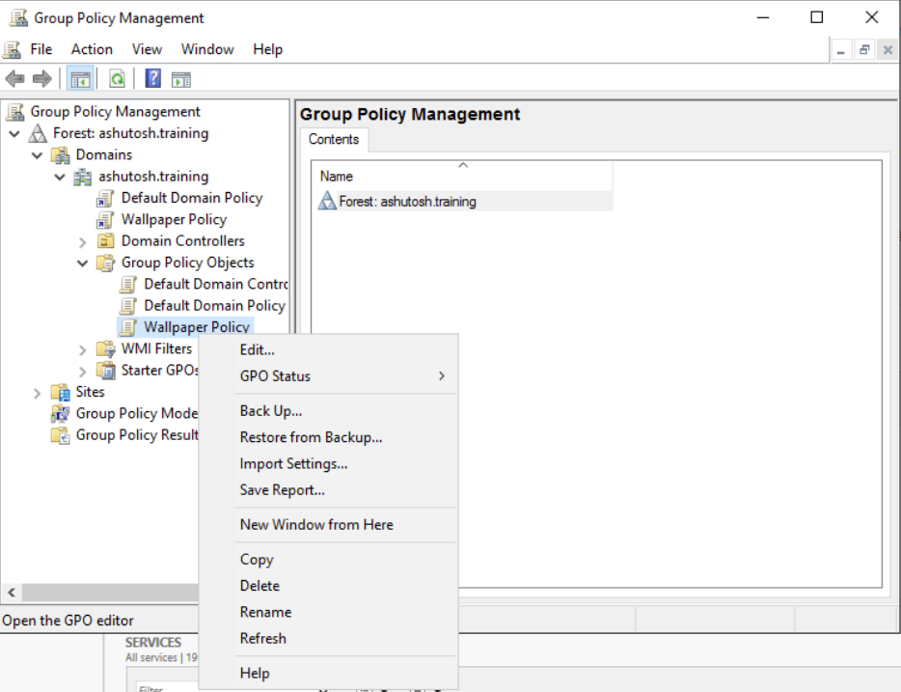
Name the GPO:
Right click on the “Wallpaper policy” & click edit:
2024 - RPS Consulting all rights reserved

Slide 7
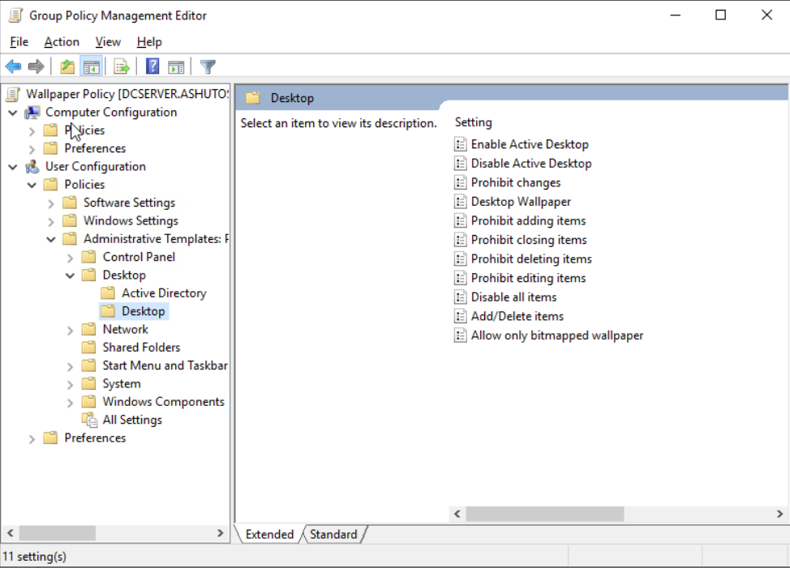
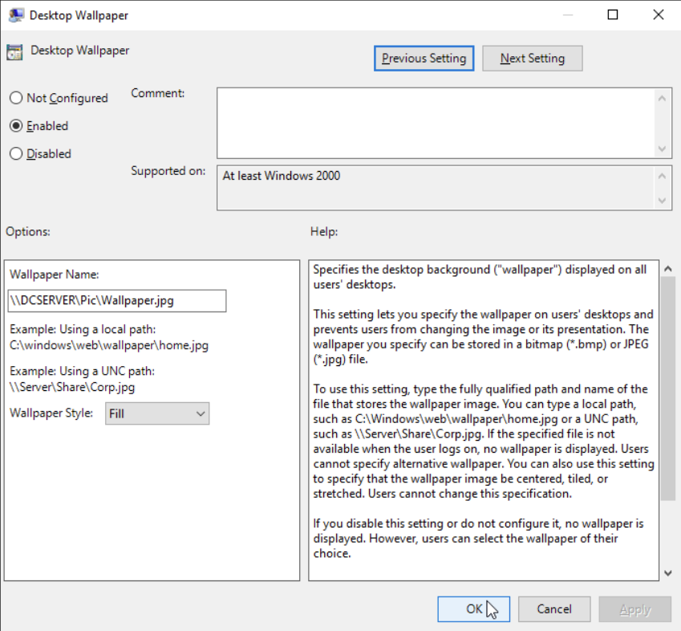
Enable it & enter the “network path” picture you wanted as wallpaper:
Click on Desktop Wallpaper:
2024 - RPS Consulting all rights reserved

Slide 8
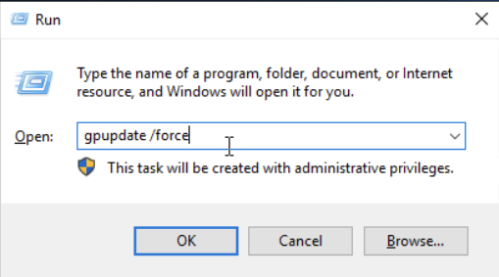
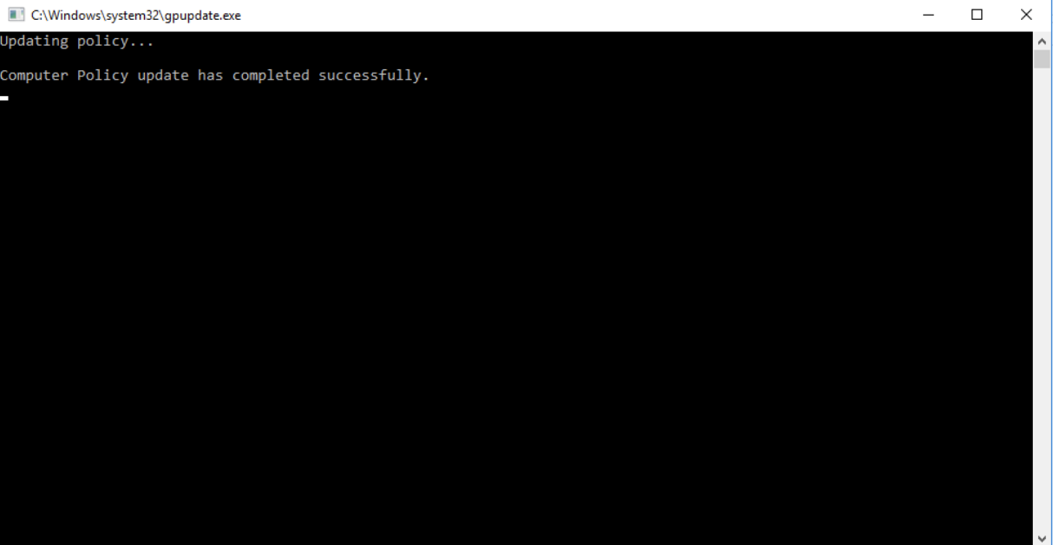
Run this command to update the Group policy:
Note: After Running this command either restart or sign out & re-login again
2024 - RPS Consulting all rights reserved

Slide 9
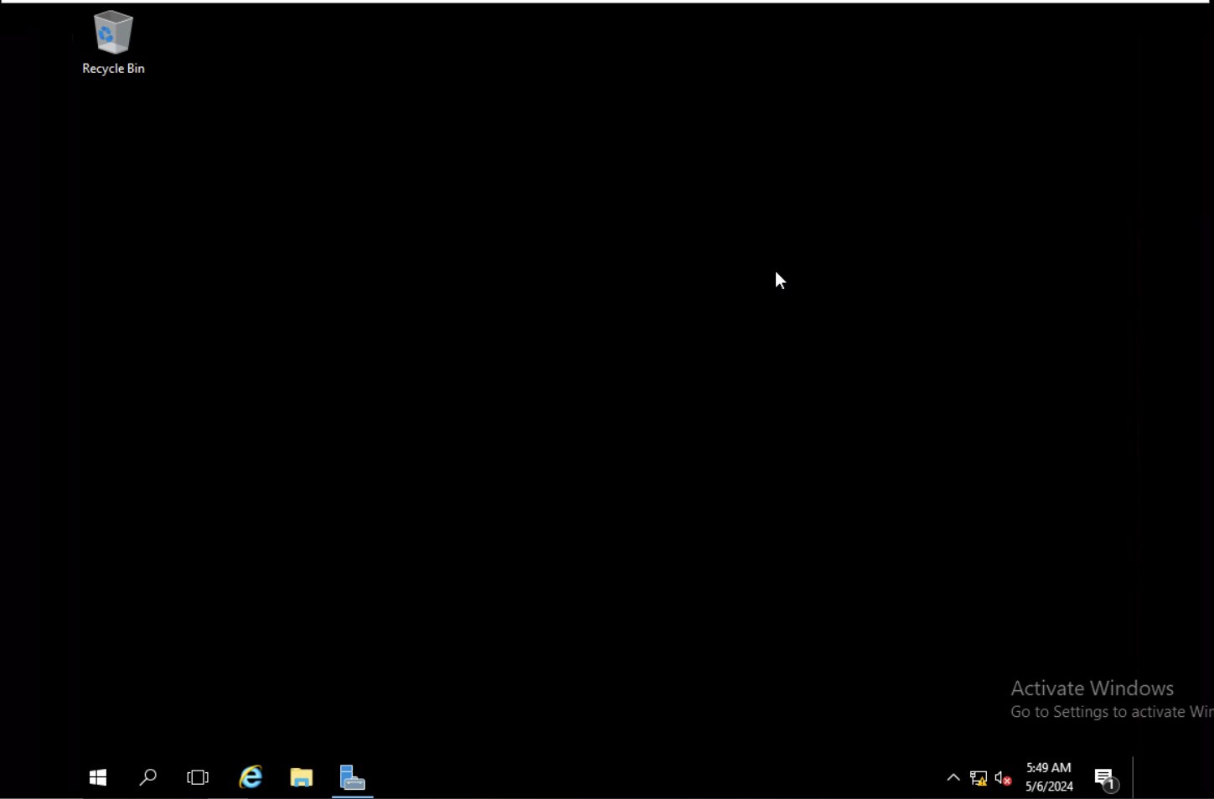
Changed wallpaper:
2024 - RPS Consulting all rights reserved

